Slide 1
Secure Data Hiding in Image using Steganography
CAPSTONE PROJECT
Presented By:
Student Name : Manoj Subburaj Yadav
College Name & Department : Alamuri Ratnamala Institute of Engineering And Technology & Computer Engineering Department

Slide 2
OUTLINE
Problem Statement
Technology used
Wow factor
End users
Result
Conclusion
Git-hub Link
Future scope

Slide 3
Problem Statement
“Secure Data Hiding in Image using Steganography” In the digital age, ensuring secure communication and data protection is a significant challenge. Traditional encryption methods secure data but often attract attention, making them susceptible to attacks. Steganography provides an alternative by concealing data within images, making the hidden information undetectable to unauthorized users. This project explores Least Significant Bit (LSB) steganography, a technique for embedding secret data into image pixels while maintaining visual integrity. The goal is to develop a secure, efficient, and undetectable method of hiding sensitive information, ensuring confidentiality and privacy in digital communication.

Slide 4
Technology used
1. Programming Language: Python – Chosen for its simplicity and powerful image-processing capabilities. 2. Libraries & Frameworks: OpenCV (cv2) – For image processing (loading, modifying, and saving images). NumPy – For handling image matrices and pixel manipulation. Pillow (PIL) – For additional image handling and manipulation. Cryptography (Optional) – If encryption is used for additional security. 3. Platform & Tools: Jupyter Notebook / Google Colab – For development and testing. PyCharm / VS Code – For writing and debugging the Python code. Windows / Linux – Compatible with any OS that supports Python.

Slide 5
Wow factors
1. Dual-Layer Security (Steganography + Encryption) Unlike basic steganography projects, this implementation can combine encryption (AES or RSA) with data hiding, making the hidden message even more secure. 2. Undetectable Data Hiding The use of Least Significant Bit (LSB) substitution ensures that the modifications in pixel values are imperceptible to the human eye, making it almost impossible to detect the hidden message. 3. Customizable & Scalable Approach The project can be extended to support audio and video steganography, making it more versatile for real-world applications. 4. Real-World Applications Can be used for secure communication, watermarking, digital forensics, and anti-piracy measures. Helpful for journalists, government agencies, and whistleblowers who need to share sensitive information discreetly. 5. Adaptive Steganography for Increased Security Advanced adaptive techniques (Pixel Value Differencing or Frequency Domain Steganography) can be incorporated to make detection harder, surpassing traditional LSB methods. 6. User-Friendly GUI (Optional Enhancement) The project can be enhanced by adding a Graphical User Interface (GUI) using Tkinter or PyQt, allowing non-programmers to easily use the tool. 7. AI-Based Detection Prevention (Future Scope) Machine learning can be used to randomly distribute hidden data across an image, making it resistant to steganalysis tools.

Slide 6
End users
1. Cybersecurity Professionals & Ethical Hackers To secure sensitive data from unauthorized access and cyber threats. 2. Government & Intelligence Agencies Used for covert communication and secure transmission of classified information. 3. Journalists & Whistleblowers Helps in safely transmitting sensitive information without attracting attention. 4. Military & Defense Organizations Can be used for secure communication in intelligence operations without being intercepted. 5. Corporate Sector & Data Security Teams Protects confidential business information and intellectual property. 6. Digital Forensics & Law Enforcement Helps in tracking cybercriminals and preserving digital evidence securely. 7. Content Creators & Copyright Protection Used for digital watermarking to prevent piracy and unauthorized distribution.

Slide 7
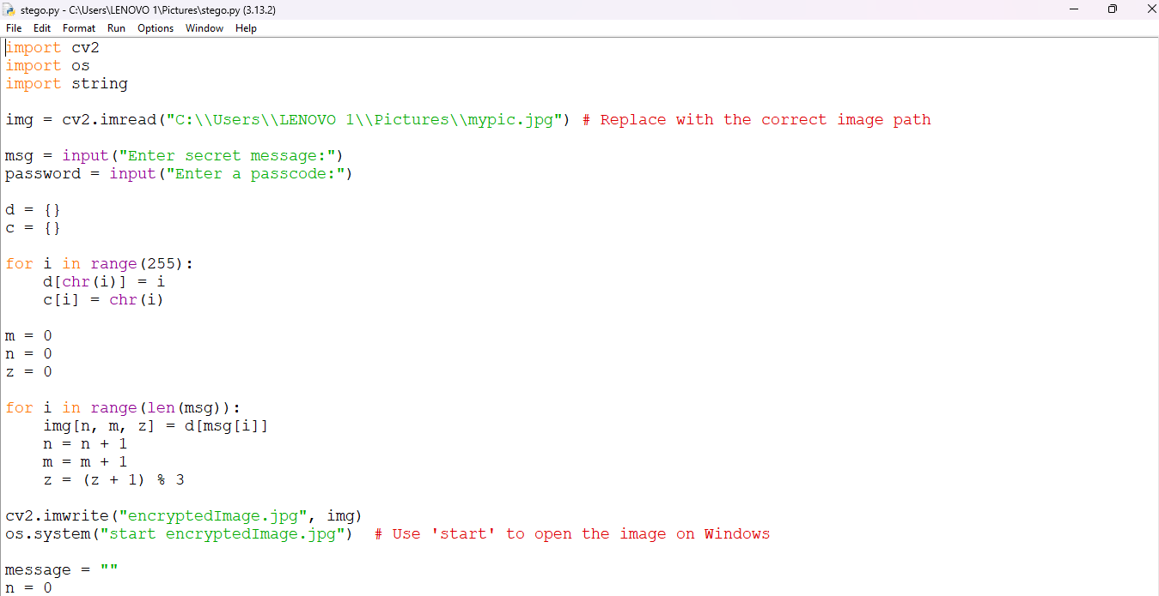
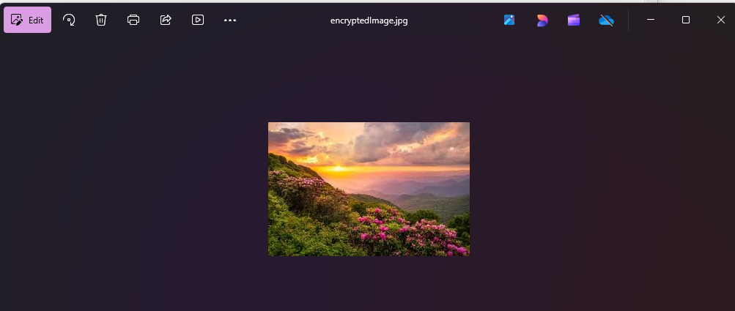
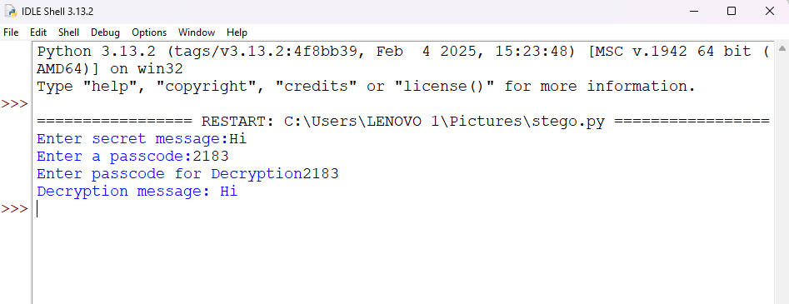
Results

Slide 8
Conclusion
The “Secure Data Hiding in Image using Steganography” project successfully addresses the challenge of secure communication by providing a method to hide sensitive data within images. Unlike traditional encryption, which may attract unwanted attention, steganography ensures that the very existence of hidden data remains undetectable. By implementing Least Significant Bit (LSB) substitution, this project demonstrates an efficient and imperceptible way to embed information in images. The solution can be further enhanced with encryption, adaptive steganography, and AI-based techniques to strengthen security. This project has real-world applications in cybersecurity, government intelligence, digital forensics, and copyright protection, making it a valuable tool for secure data transmission. With further advancements, it can be adapted for audio, video, and large-scale secure communication systems.

Slide 9
GitHub Link
https://github.com/Spmanoj593/Secure-Data-Hiding-in-Image-using-Steganography

Slide 10
Future scope(optional)
1. Advanced Steganography Techniques Implementing Discrete Cosine Transform (DCT) or Wavelet Transform techniques for hiding data in the frequency domain, making detection even harder. 2. Steganography in Multiple Media Formats Expanding the project beyond images to audio, video, and text steganography, enhancing its applicability in secure communication. 3. AI-Powered Steganography Using machine learning and deep learning to dynamically adjust pixel modifications, reducing the chances of steganalysis detection. 4. Blockchain Integration for Secure Communication Combining steganography with blockchain to create a tamper-proof and traceable secure messaging system.

Slide 11
THANK YOU

